Slide 1
3rd year project

Slide 2
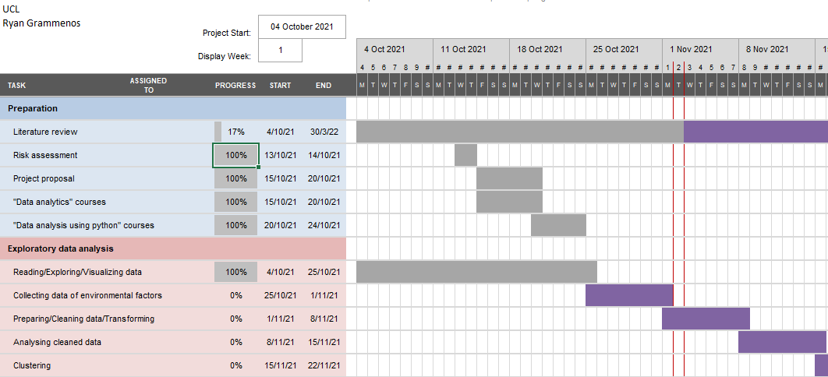
Last week: Collecting weather data
This week: Preparing, cleaning, transforming the dataset

Slide 3
Progress since last meeting
Collecting historical weather data
Searching for historical weather data archives
Found a source with data for every 30 minutes over the entire time interval of our dataset (BUT not free – dataset available from last year?)
Found an alternative source for manually filling in missing data/correcting suspicious values if needed
Preparing, cleaning, transforming the dataset
Literature review
No hands-on work…yet!

Slide 4
Questions
Weather data available from last year?
Larger dataset available?
  Different buildings
  Further readings from 2020
  Building occupancy

Slide 5
Plans for next meeting (16th Nov.)
Finishing “Preparing, cleaning, transforming the dataset”
Performing analysis on the dataset / Replicating results from last years MSc student
Starting with the clustering process
Literature review
  Finishing the entire report from last years MSc student
  Reading the relevant sources cited in the report
  Further reading from other sources on the same topic
  Reading more about real time anomaly detection

Slide 6
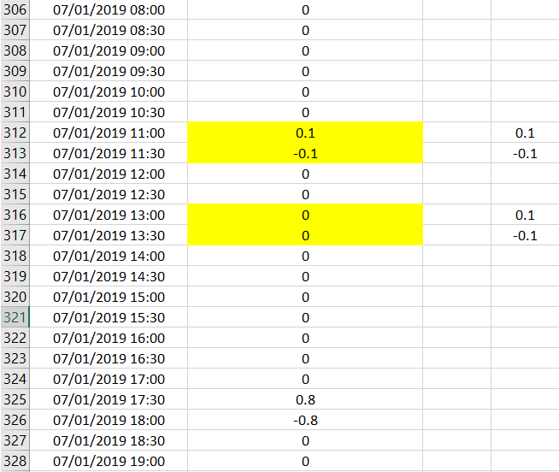
Meeting 16th

Slide 7
Progress week 9
Preparing questions for Xenia
Meeting with Xenia
Working on the interim report
Filling gaps in the labbook
Marking important parts for interim report
Reading journals for the reference part
Identifying goals

